Slide 1
Mobile Sensors Workshop, Part 1: Analog
Pierce Nichols
17 October 2014

Slide 2
What we will be covering
Introductions: who are you and what do you hope to get out of this class?
What is a sensor?
Sensing systems
Pots and switches as sensors
Signal conditioning circuits
Resistive sensors
Piezo sensors
Other sensors

Slide 3
Software Setup
Download and install the following things:
Arduino IDE
Processing
Class files (https://github.com/logos-electromechanical/SensorWorkshop)
Libraries

Slide 4
What is a sensor?
Broadly, a “device that receives and responds to a signal or stimulus”, including:
Eyes
Lateral line of a fish
Thermometer
Inner ear
For the purposes of this workshop, a device that produces an electrical signal in response to a physical signal of some kind.
Sensors are (almost) always part of a larger system that records or acts on their output.

Slide 5
Sensing systems
Typical sensing system diagram
Sensor
Signal Conditioning
Analog to Digital Conversion (ADC)
Processing
Display

Slide 6
Sensor inputs and outputs
Heat/temperature
Light
Mechanical deformation
Radiation
Magnetic fields
Chemical
Other
Voltage
Current
Charge
Resistance
Frequency
Inductance
Capacitance

Slide 7
Sensor properties
Sensitivity – the change in sensor output per change in input
Span – the highest and lowest values that the sensor can measure
Accuracy – how close the measurement is to the real value. Generally expressed as a percentage of the span.
Precision/Repeatability – how close subsequent measurements of a fixed quantity are to each other. Generally expressed as a percentage of the span.
Resolution – how small a change in the measured quantity the sensor can detect.

Slide 8
Sensor properties, continued
Linearity – How much the response of the sensor varies from a straight line. Generally expressed a percentage of the straight-line value.
Hysteresis – how much the measurement of a changing quantity changes with direction of change.
Offset – sensor output at zero input

Slide 9
Sensor system
Sensor
Signal Conditioning
Analog to Digital Conversion (ADC)
Processing
Display

Slide 10
Signal Conditioning
Most sensor outputs are a poor match for most ADCs
Wrong signal type
Wrong voltage level/range
Wrong offset
Noisy/out of ADC frequency range
Some sensors require precise excitation signals
Signal conditioning often includes amplification, offset selection, and filtering.

Slide 11
Sensor system
Sensor
Signal Conditioning
Analog to Digital Conversion (ADC)
Processing
Display

Slide 12
Analog to Digital Conversion (ADC)
Analog to digital converter measures the (usually) voltage level numerous times per second and transforms it into a digital value
Splits the input into 2^{n} discrete buckets, where n is the number of bits.
Our Arduinos have a 10-bit ADC, which gives values from 0-1023
Measures value at discrete points in time
Can produce aliasing when measuring high frequency signals

Slide 13
Sensor system
Sensor
Signal Conditioning
Analog to Digital Conversion (ADC)
Processing
Display

Slide 14
Processing
ADC output is in the form of digital codes that do not correspond directly to engineering units.
Sensor output may require application of calibration
Common processing steps include
Scaling (i.e. 0-1023 scaled to 0-5V)
Offsets
Calibration
Digital filtering

Slide 15
Sensor system
Sensor
Signal Conditioning
Analog to Digital Conversion (ADC)
Processing
Display

Slide 16
Display
The data must be presented in some way that a consumer can act on.
Common examples:
Strip charts
Oscilloscope
Digital numeric displays
Dials
Transmitted to another system

Slide 17
Impedance & Thévenin's theorem
Any linear electrical network with voltages, current sources, and resistances can be replaced with a single voltage source putting out V_{th} and a single series resistor of value R_{th}
The equivalent resistance of a battery is why it doesn’t turn into a grenade when you short the terminals.
R_{th} is also called impedance when we’re talking about circuit outputs.
In a circuit input, impedance is the equivalent resistance to ground.
For quasi-DC circuits, ideal outputs have 0 impedance & ideal inputs have ∞ impedance.
AC & RF are different…

Slide 18
Other terms to know…
Transfer function – the function that relates the output of a sensor or circuit to its input.
Decibels (dB) – a logarithmic unit for describing ratios. More on this tomorrow.
Bandwidth – the span between the highest and lowest frequency a system will pass. If it will pass DC, then this is the maximum frequency it will pass.
Low pass – a system that will only pass signals below a certain frequency. All real systems have low-pass characteristics.
High pass – a system that will only pass signals above a certain frequency. This is not mutually exclusive with low pass.

Slide 19
Signal conditioning circuits (a small sampling)
Voltage amplifiers
Current to voltage amplifiers (aka transimpedance amplifier)
Charge amplifiers
Frequency to voltage converters (and vice versa)
Excitation circuits (voltage sources, current sources, frequency sources, etc)
Filters

Slide 20
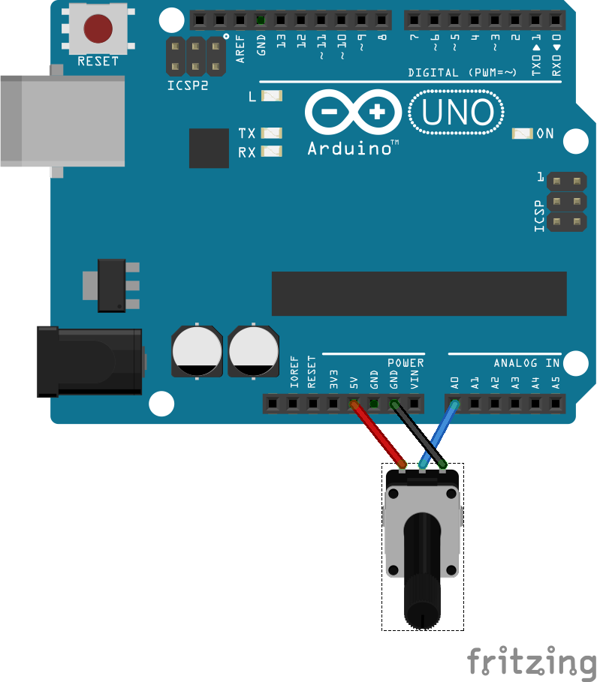
Pot as position sensor
If we connect one side the potentiometer to a voltage source and the other side to ground, the voltage at the wiper is proportional to the position of the pot
Connect a pot to your Arduino as shown to the right.

Slide 21
Potentiometer position sensor code
Open the ‘one_channel_scope.pde’ sketch with Processing
Open the ‘one_channel_scope.ino’ sketch with Arduino & program it

Slide 22
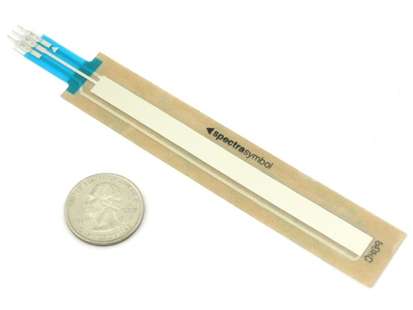
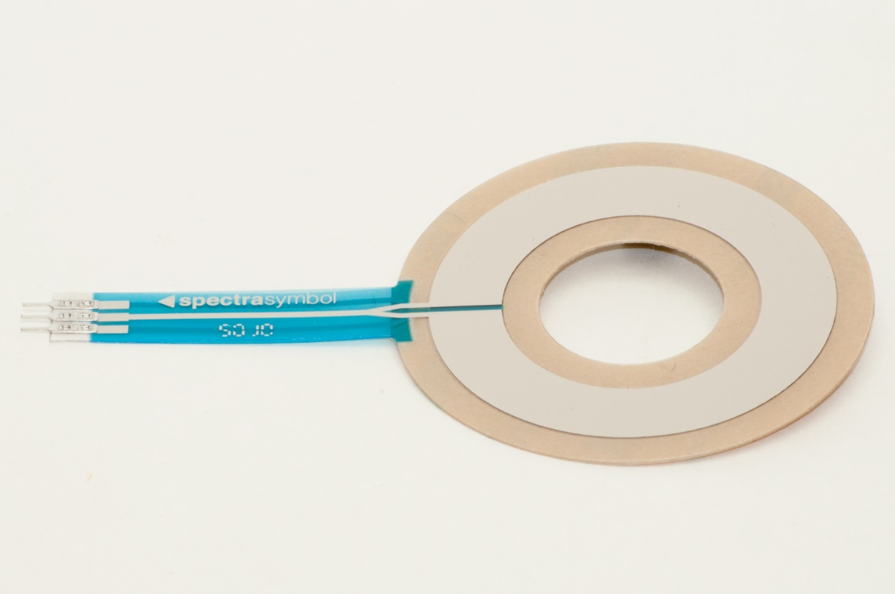
Softpots
These are potentiometers whose wiper is formed by pressing on the strip.
They are flexible and have adhesive backs; easy to integrate
Often used for position sensing and user interface.
Electrically identical to other pots.

Slide 23
Potentiometer pros and cons
Pros
Cons
Cheap
Easy circuitry
Large electrical range
Available in a huge variety of different grades and form factors
Noisy
Poor durability
Output impedance is excessively high, so it is sensitive to loading.

Slide 24
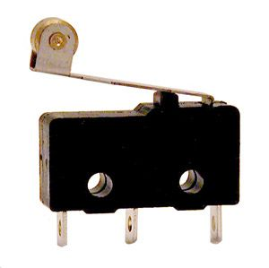
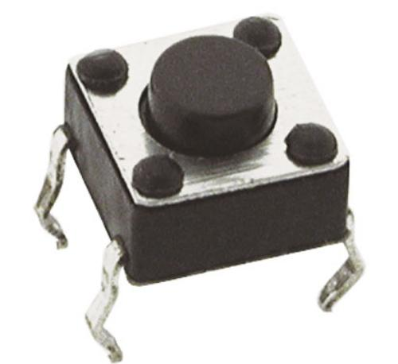
Switches as sensors
Switches are often used for sensing position limits
End stops on CNC machines are frequently implemented with switches.
Can be attached to all sorts of actuators, such as level floats.
Also widely used for user interface

Slide 25
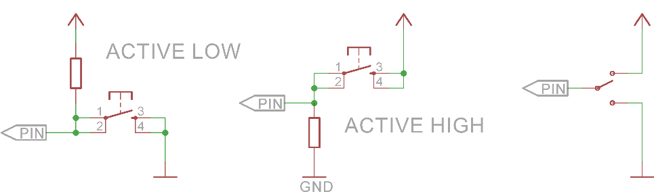
Typical switch sensing circuits
Your Hall effect sensor works like this one…

Slide 26
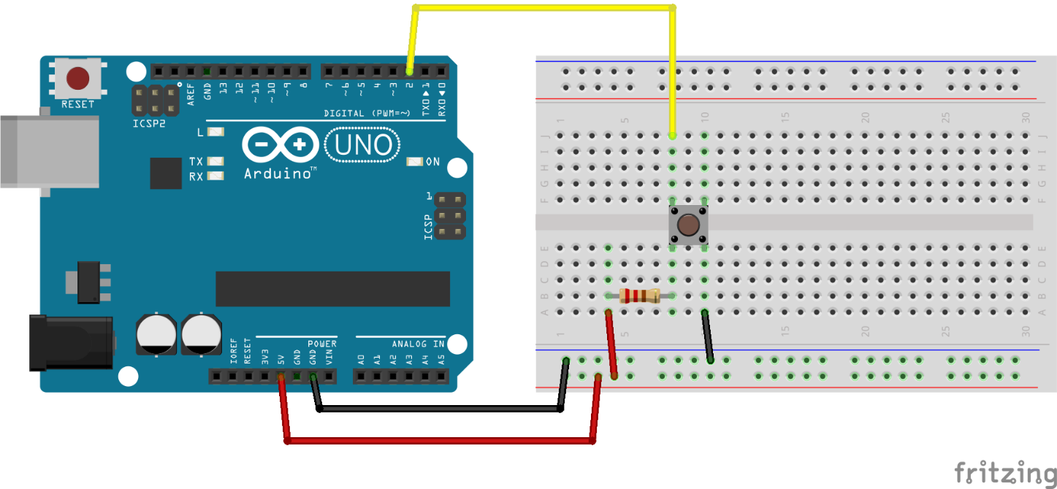
Switch sensing circuit & code
Use Button example code
Hookup shown is active low

Slide 27
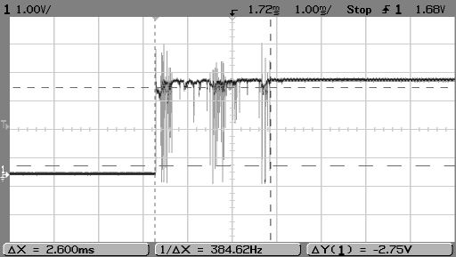
Debouncing
Switches do not transition smoothly…
Mechanical contacts bounce!
This may cause undesired behavior if you’re trying to count switch activations.
Most common way to debounce with a microcontroller is to check twice (say 3 ms apart for this switch)

Slide 28
Switch code with de-bounce
Use Arduino Debounce example

Slide 29
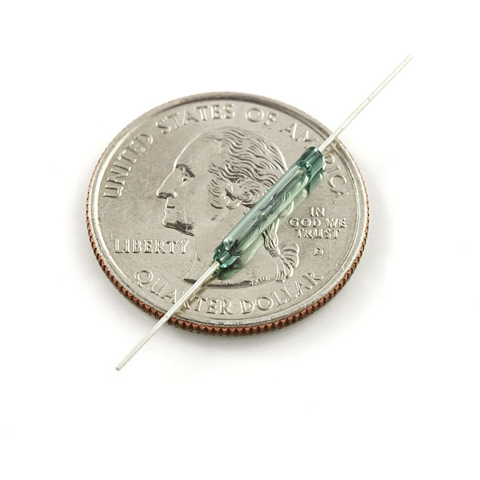
Reed switch
A small switch actuated by a magnetic field
Electrically, it’s just like the button
Can be used to sense position and presence.

Slide 30
Ten minute break…

Slide 31
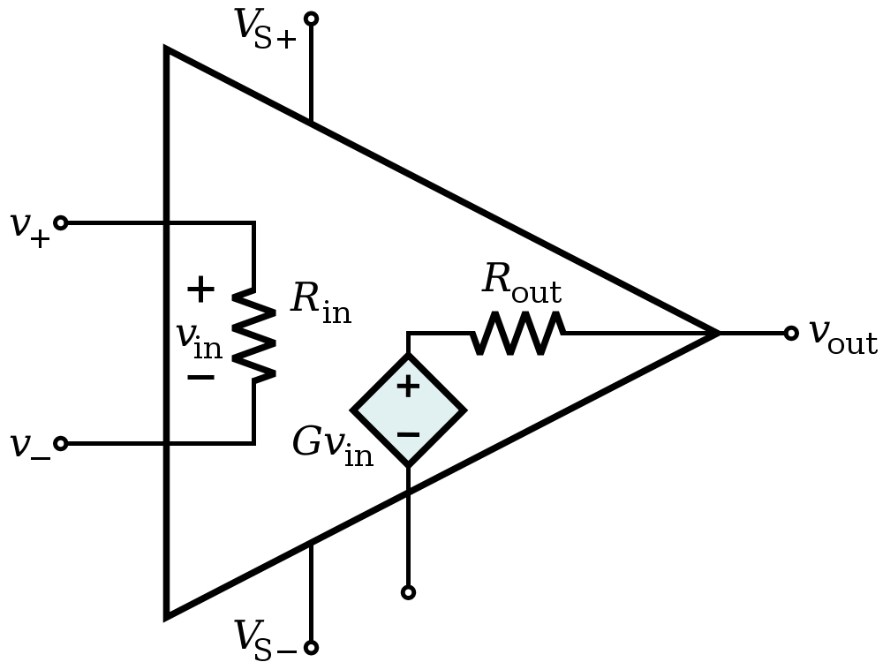
Amplifier circuits
Typical instrumentation amplifiers are built with operational amplifiers (usually called op-amps).
Two golden rules:
The output of the op-amp will change to keep the positive and negative inputs equal.
The inputs draw no current.

Slide 32
Feedback
Feedback is key to doing useful things with op amps.
Positive feedback is where we connect the output back to the positive input through some circuit.
Negative feedback is where we connect the output back to the negative input through some circuit, and is by far the more common and useful mode.

Slide 33
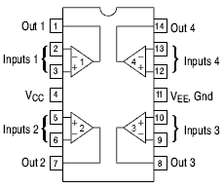
Our Op-Amps
We’re using the MCP6004, which has four op-amps in a single 14 pin DIP package.
Most quad op-amps share the same pinout.
It’s a common, cheap part with a power supply range from 1.8V to 6.0V
This is a rail-to-rail part, which means that the input and output can go all the way to the voltage rails.

Slide 34
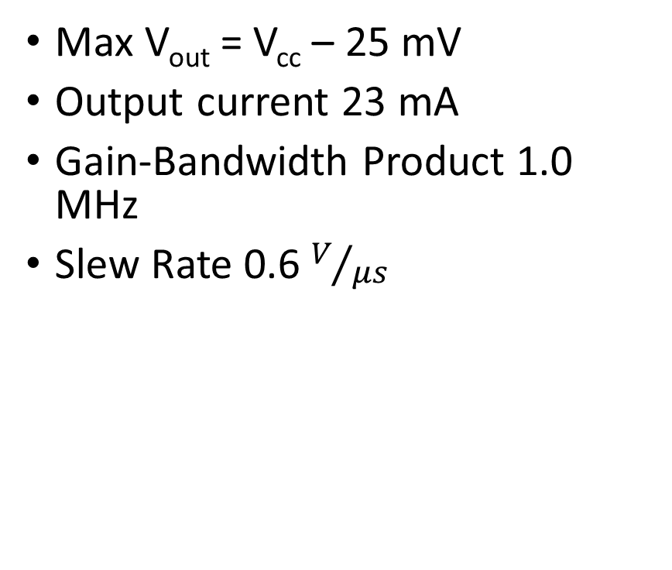
Key Datasheet Values
Common mode voltage range includes rails + 300 mV
Input offset voltage 4.5
mV
Input offset current 1 pA
Input bias current 19 pA
Open loop gain 112 dB
CMRR 76 dB (typ)
PSRR 86 dB (typ)
Max V_{out} = V_{cc} – 25 mV
Output current 23 mA
Gain-Bandwidth Product 1.0 MHz
Slew Rate 0.6 $V/{μs}$

Slide 35
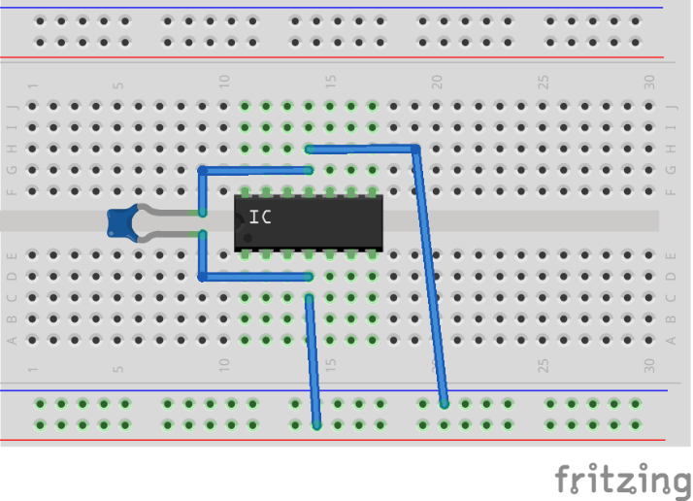
Power setup

Slide 36
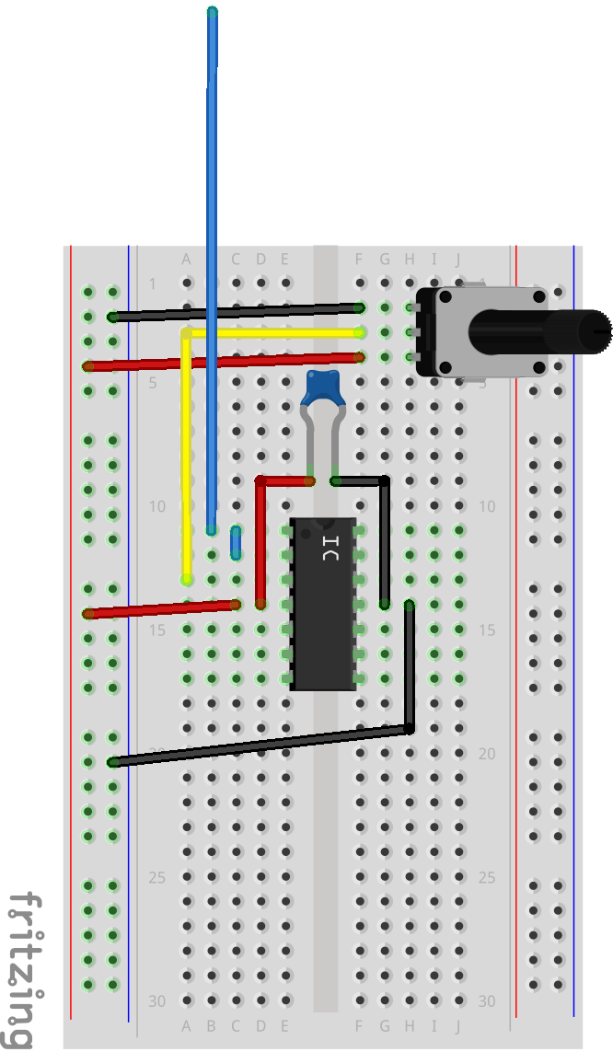
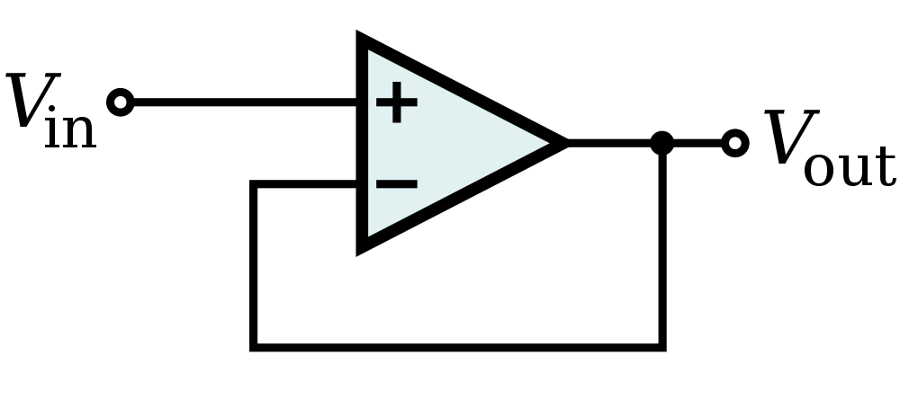
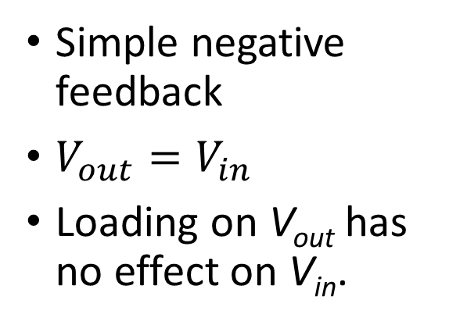
The Voltage Follower
Simple negative feedback
$V_{out}=V_{in}$
Loading on V_{out} has no effect on V_{in}.

Slide 37
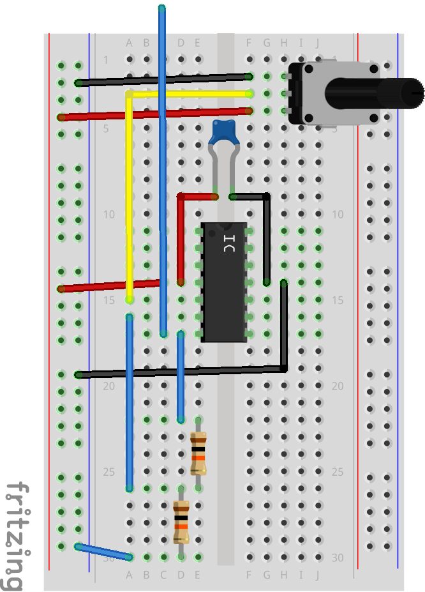
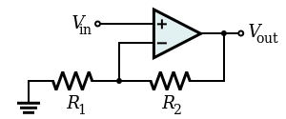

Non-Inverting Amplifier
Let’s add a voltage divider to the feedback…
$V_{out}=\left(1+\frac{R_{1}}{R_{2}}\right)V_{in}$
$Z_{in}=R_{in}×G_{OL}≈∞$

Slide 38
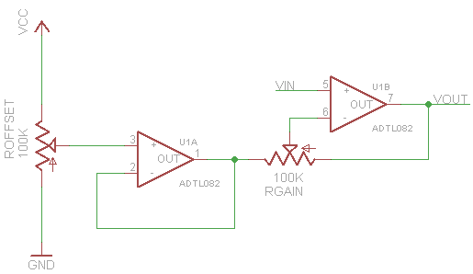
A quick word about ground
Ground in all these circuits is where you choose to put it.
Therefore, we can use it to introduce output offset

Slide 39
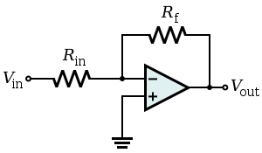
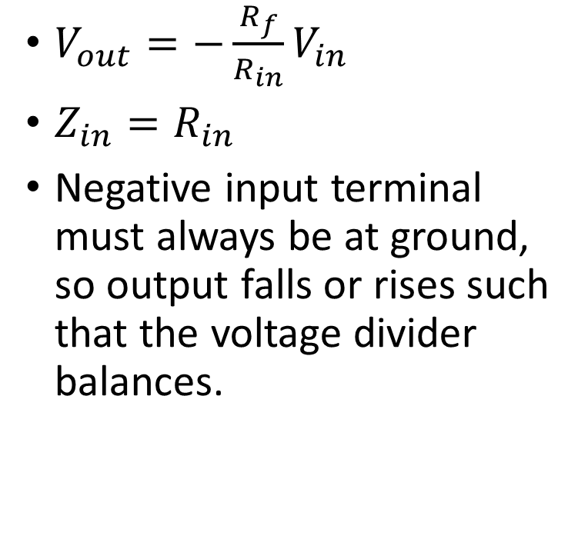
Inverting Amplifier
$V_{out}=−\frac{R_{f}}{R_{in}}V_{in}$
$Z_{in}=R_{in}$
Negative input terminal must always be at ground, so output falls or rises such that the voltage divider balances.

Slide 40
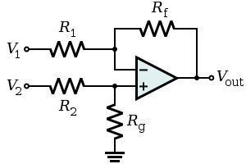
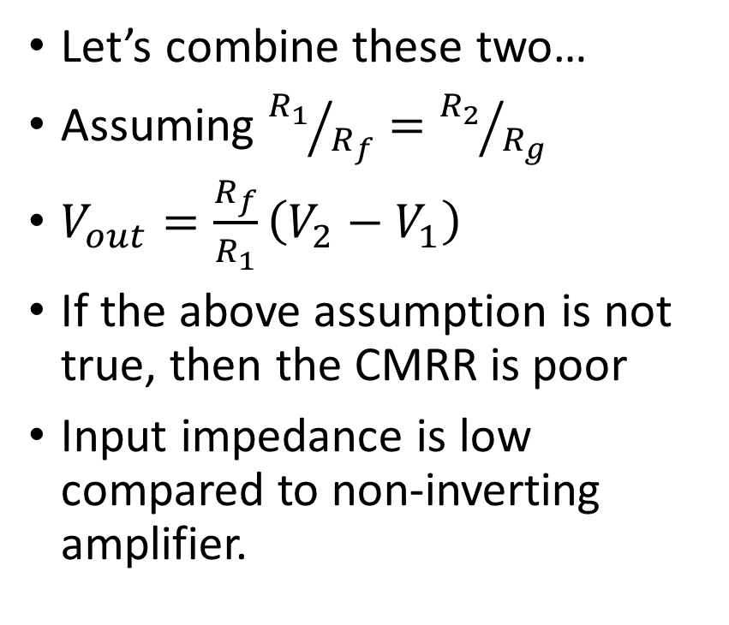
Differential Amplifier
Let’s combine these two…
Assuming ${R_{1}}/{R_{f}}={R_{2}}/{R_{g}}$
$V_{out}=\frac{R_{f}}{R_{1}}\left(V_{2}−V_{1}\right)$
If the above assumption is not true, then the CMRR is poor
Input impedance is low compared to non-inverting amplifier.

Slide 41
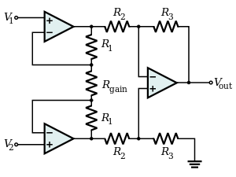
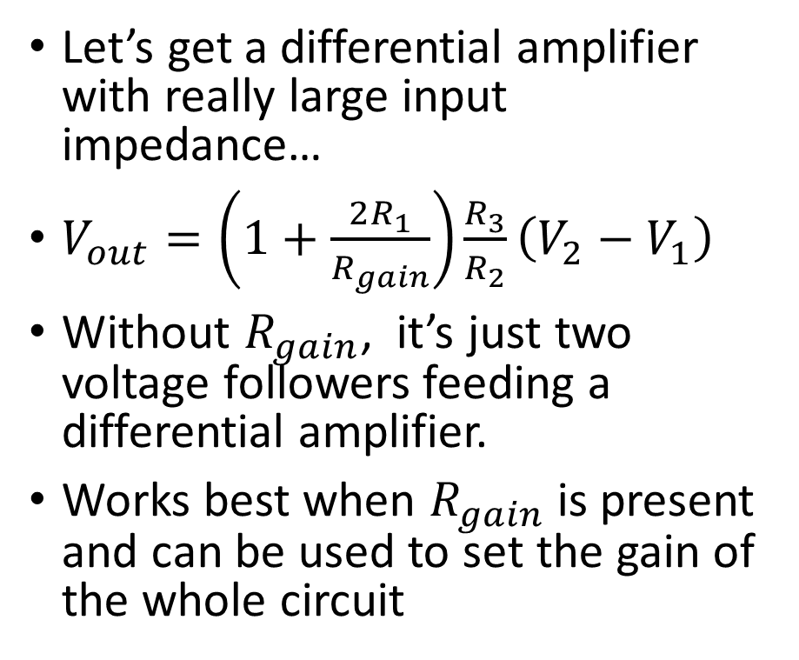
Instrumentation Amplifier
Let’s get a differential amplifier with really large input impedance…
$V_{out}=\left(1+\frac{2R_{1}}{R_{gain}}\right)\frac{R_{3}}{R_{2}}\left(V_{2}−V_{1}\right)$
Without $R_{gain}$, it’s just two voltage followers feeding a differential amplifier.
Works best when $R_{gain}$ is present and can be used to set the gain of the whole circuit

Slide 42
Ten minute break…

Slide 43
Resistive sensors
Many sensor types produce a varying resistance…
Bend sensors
Photocell
Force-sensitive resistor
Thermistor
We can produce a synthetic pot with a resistor and an amplifier…

Slide 44
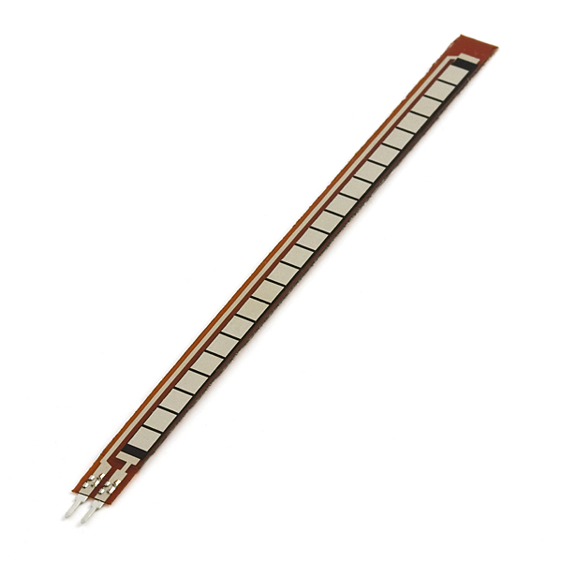
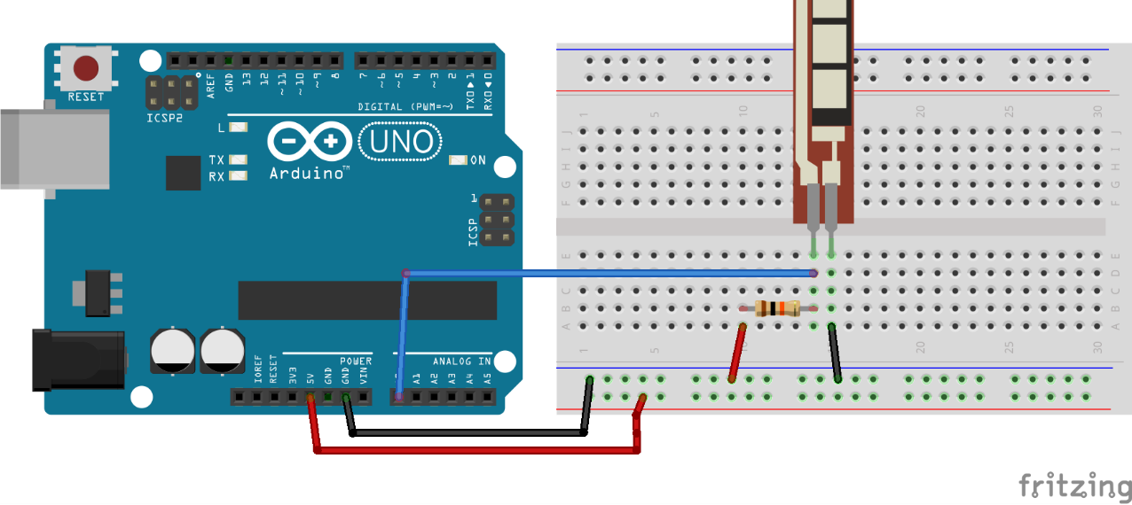
Wiring up the bend sensor…

Slide 45
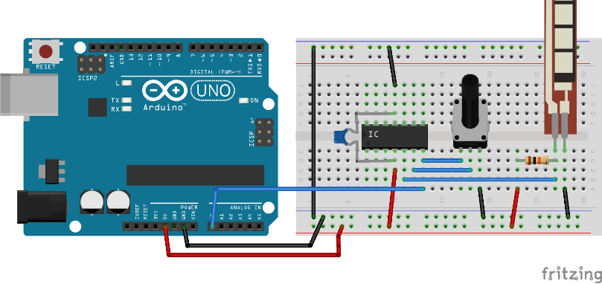
Adding an amplifier…

Slide 46
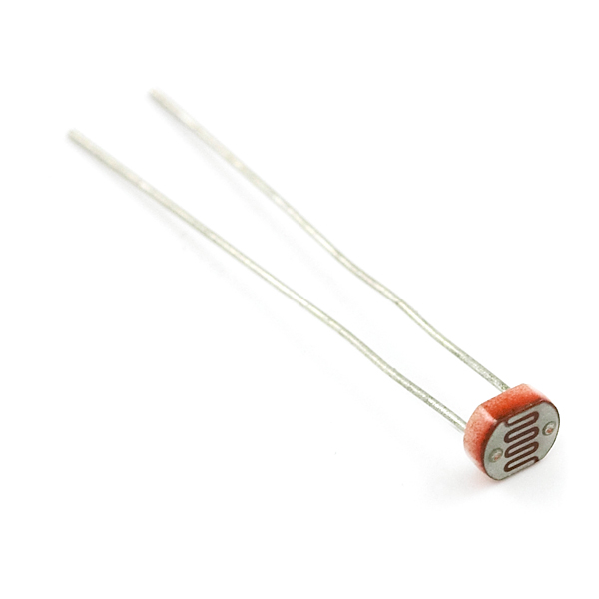
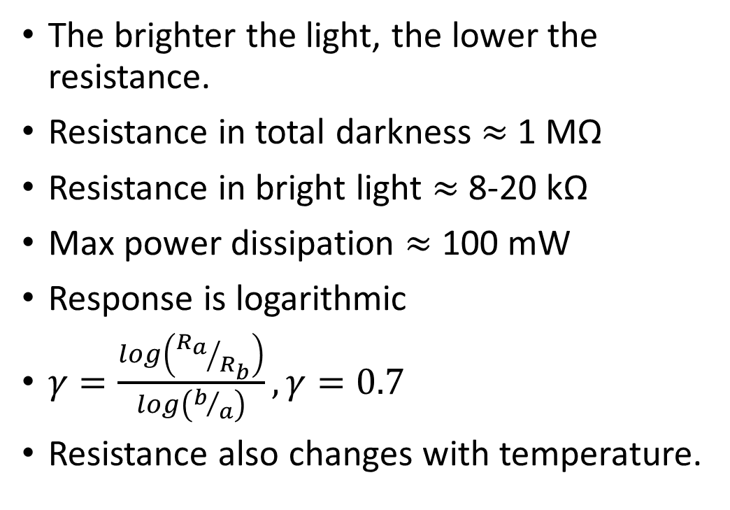
Swap in the photocell
The brighter the light, the lower the resistance.
Resistance in total darkness $≈$ 1 MΩ
Resistance in bright light $≈$8-20 kΩ
Max power dissipation $≈$ 100 mW
Response is logarithmic
$γ=\frac{log\left({R_{a}}/{R_{b}}\right)}{log\left(b/a\right)}, γ=0.7$
Resistance also changes with temperature.

Slide 47
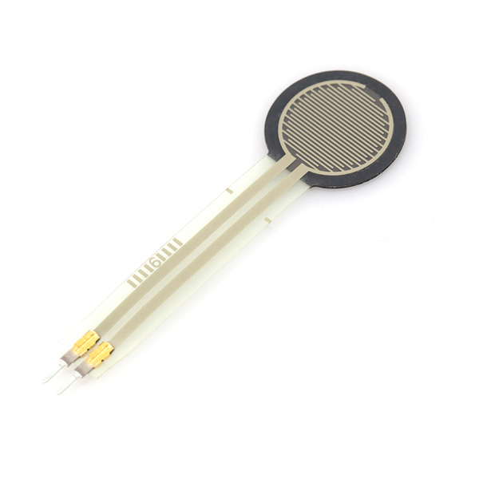
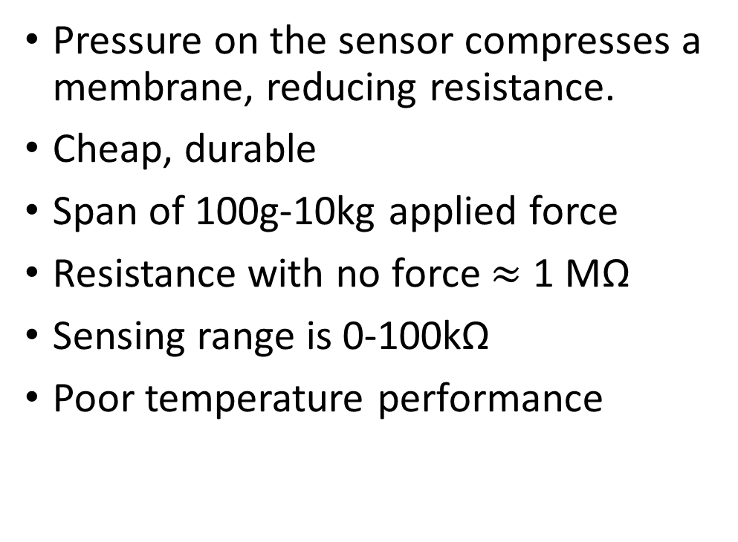
Swap in the force sensitive resistor
Pressure on the sensor compresses a membrane, reducing resistance.
Cheap, durable
Span of 100g-10kg applied force
Resistance with no force $≈$ 1 MΩ
Sensing range is 0-100kΩ
Poor temperature performance

Slide 48
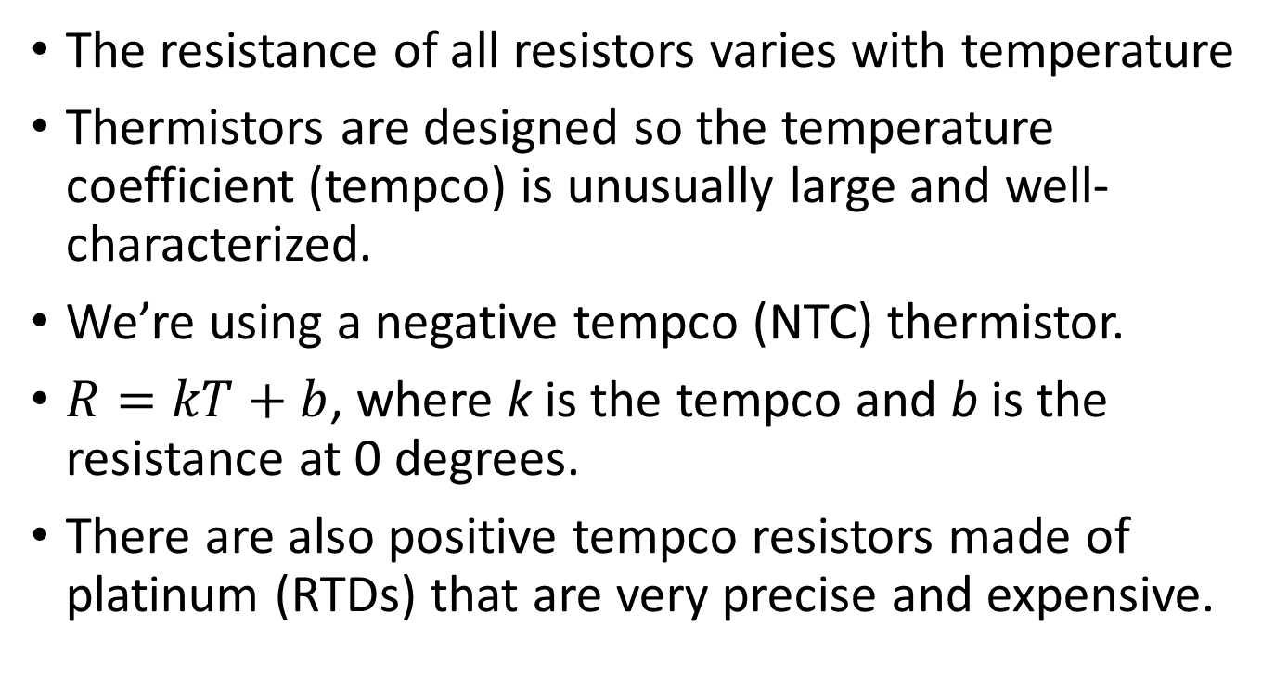
Swap in a thermistor
The resistance of all resistors varies with temperature
Thermistors are designed so the temperature coefficient (tempco) is unusually large and well-characterized.
We’re using a negative tempco (NTC) thermistor.
$R=kT+b$, where k is the tempco and b is the resistance at 0 degrees.
There are also positive tempco resistors made of platinum (RTDs) that are very precise and expensive.

Slide 49
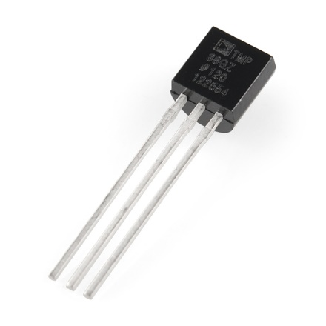
Integrated temperature sensor
TMP36
Voltage Input: 2.7 V to 5.5 VDC
10 mV/°C scale factor
±2°C accuracy over temperature
±0.5°C linearity
Operating Range: −40°C to +125°C
750 mV @ 25° C
Combines sensor & signal conditioning in one device.

Slide 50
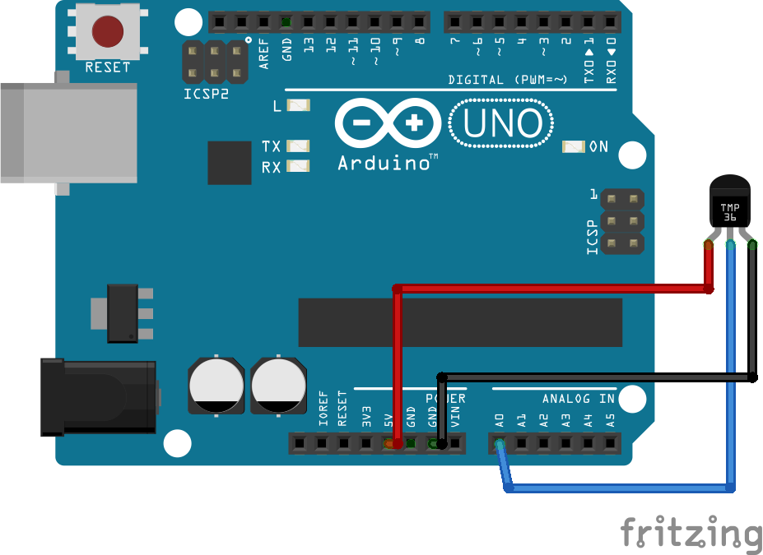
Hooking up the integrated temperature sensor

Slide 51
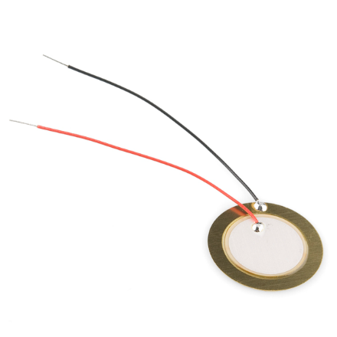
Piezo element
When an insulator is deformed, it creates an electric charge. This is the piezoelectric effect.
It also works in reverse, i.e. applying an electric charge to an insulator deforms it.
We can use it to detect sound or vibration… such as we get from a knock.
It can also be used as a speaker
This dual speaker/microphone role is use for ultrasonic transducers.

Slide 52
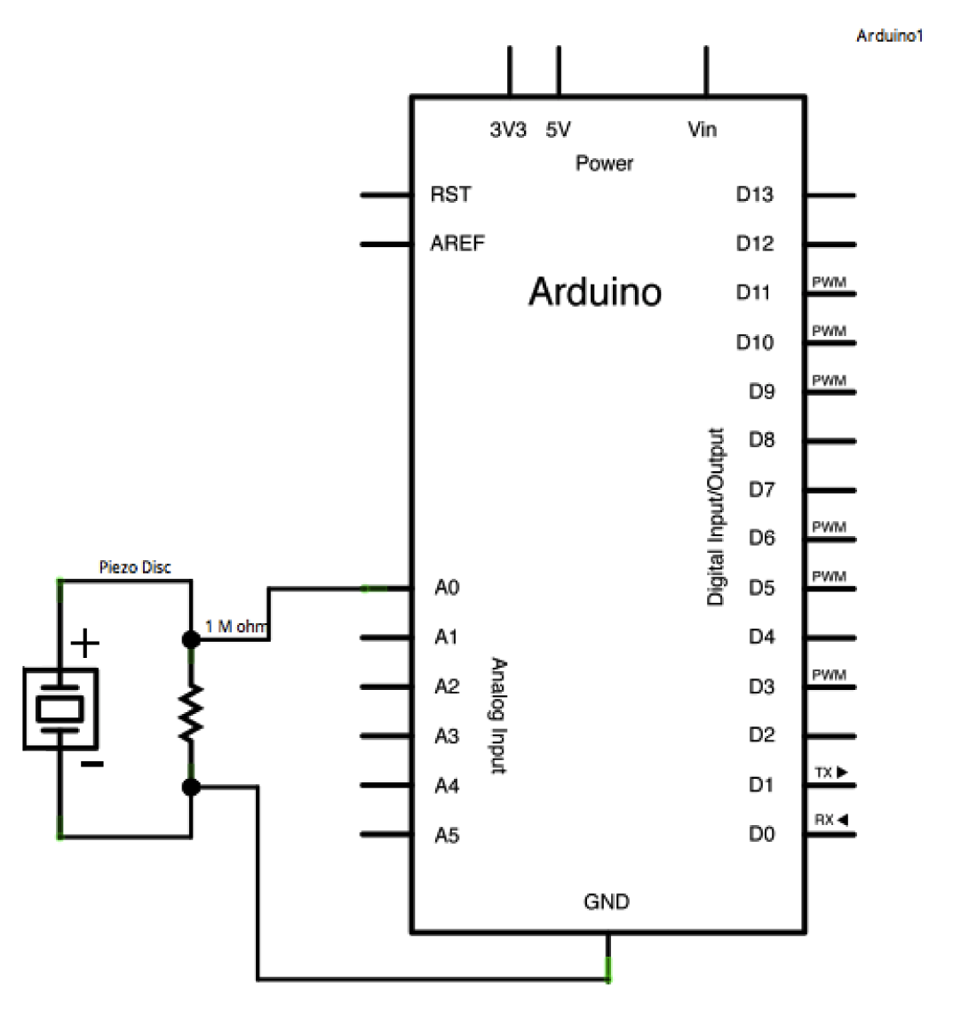
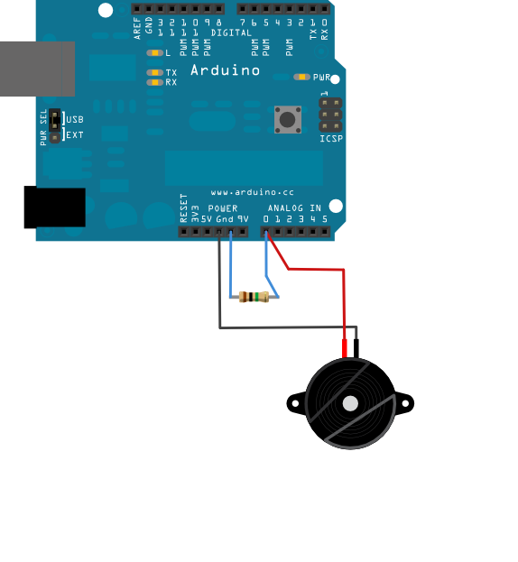
Piezo wiring
Load the Knock sketch from the examples
No Processing

Slide 53
Ten minute break…
And then a review of a couple of other useful sensor types…

Slide 54
Thermocouples
Take two wires of different materials…
Twist them together at the ends…
Put the ends at different temperatures…
And you get a voltage proportional to the temperature difference!
This voltage is tiny – type K (chromel/alumel) thermocouples generate 41 µV/°C.
Requires some absolute measurement of the cold junction (the measured end)
An instrumentation amplifier is the usual interface circuit

Slide 55
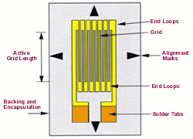
Strain gauge
A deformation sensitive resistor in the form of foil on an insulating backing.
Tension parallel to the grid increases resistance.
Resistance change is small (typically a fraction of a percent full span) but precise and repeatable.
How to measure?

Slide 56
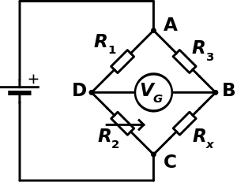
The Wheatstone Bridge
The Wheatstone bridge is a circuit for measuring very small changes in resistance.
One, two, or all four resistors can be strain gauges.
Accuracy is dependent on resistor accuracy.
An equal change to all resistors results in no change in output…
Output is proportional to excitation voltage.

Slide 57
Load cells and pressure transducers
Four strain gauges and well-characterized diaphragm or beam make a very accurate pressure or force sensor
The four gauges are arranged around the beam or diaphragm such that thermal expansion/contraction cause no change in output.
Many companies sell chips that encapsulate excitation + amplification in a single chip, like the INA125.
You can also get pressure transducers and load cells that encapsulate all of the signal conditioning.

Slide 58
Capacitive sensing
Useful for user interface elements
Also good for level and presence sensing
Can be implemented directly from Atmel microcontrollers using (closed source) QTouch library
QTouch doesn’t work with Arduino, but some other people have done it with Arduinos.

Slide 59
And that’s all for today

